Slide 1
Measuring Stellar Abundances
Raihan Malik, Seth Ketchem
Group 8

Slide 2
Motivation
Understand:
Curve of growth method
How stellar abundance is properly measured
Boltzmann & Saha equations + application
Report results in ways that physicists / astronomers do

Slide 3
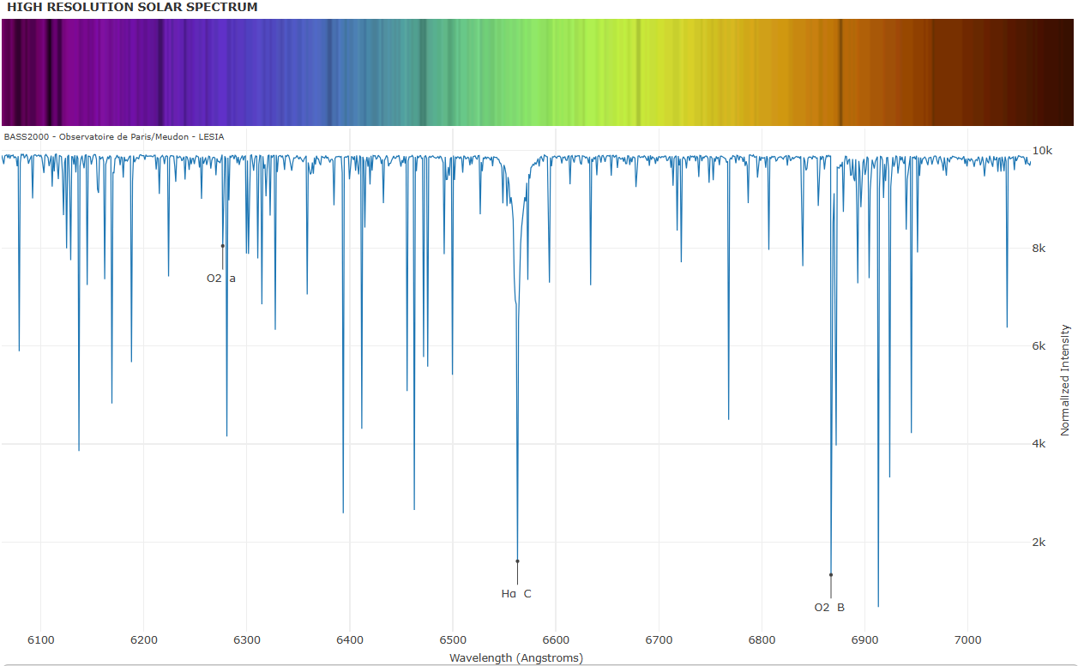
Spectroscopic Data
Utilized to find the equivalent width
=> The width of a rectangle such that its area is equal to the area within the spectral line

Slide 4
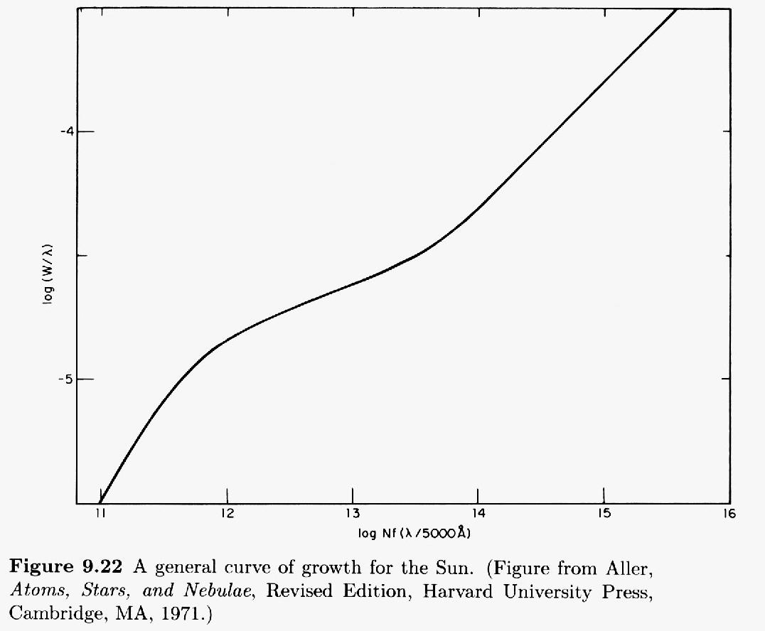
Curve of Growth
Find corresponding x-value
Using equivalent width and absorption wavelength
Find N, the number density of Sodium

Slide 5



Boltzmann
Saha
Combined Ratios
Find ratio of grounded state vs excited state
Find ratio of neutral to ionized
Find total column density

Slide 6
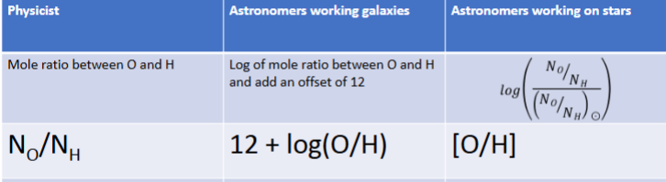
The three main ways to present abundance

Slide 7
Results
N = 8.24 x 10¹⁴ (from curve of growth)
N₂/N₁ = 0.0434 (from Boltzmann)
N_{aII}/N_{aI} = 2477.66 (from Saha)
Column Density = 2.13 x 10¹⁸

Slide 8
3.23 x 10⁻⁶
6.51
0.209

Slide 9
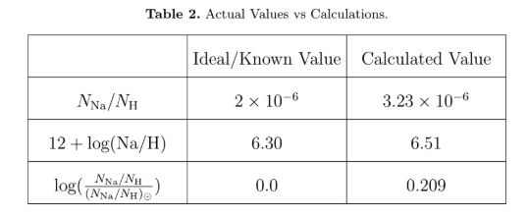
Conclusion
Our measurement and calculations for the NA abundance are consistent with known values
Error from a combination of factors:
Assumption of oscillator strength
Estimate from the curve of growth
Calculation of equivalent width.

Slide 10
Questions?
Division of Work
Coding - Raihan Malik, Seth Ketchem
Paper - Seth Ketchem
Presentation - Raihan Malik

